Slide 1
CELLS
IT’S ALIVE!!!!!!!!!!!

Slide 2
The Cell Theory
The first lenses were developed in Europe in the late 1500’s by merchants needing to determine the quality of cloth.
In Holland in the early 1600’s, two useful instruments were constructed: the telescope and the microscope.
In the 1600’s Anton van Leeuwenhoek became one of the first people to use a microscope to study nature.
His simple microscope enabled him to see things that no one had ever seen before.
In 1665, English physicist Robert Hooke used on of the first light microscopes to look at thin slices of plant tissues.
Cork caught his eye because it seemed to be made of thousands of tiny chambers he called “cells”.
Cells are the basic units of all forms of life.
In 1838, German botanist Matthias Schleiden concluded that all plants are made of cells.
The next year, another German scientist, Theodor Schwann, concluded that all animals are also made of cells.
Rudolf Virchow determined all cells must come from preexisting cells.

Slide 3
These discoveries are summarized in the Cell Theory, one of the fundamental concepts of Biology.
The Cell Theory states the Following:
1. All living things are composed of cells.
2. Cells are the basic units of structure and function in living things.
3. New cells are produced from existing cells.

Slide 4
Basic Cell Structures…
Cells can range in size from 0.2 micrometers (tiny bacteria) to 1000 micrometers (giant amebas).
All cells have a CELL MEMBRANE.
The Cell Membrane is a thin, flexible barrier around the cell.
Many cells also have a strong layer around the cell membrane known as the Cell Wall.
Cell Membranes and Cell Walls support and protect cells, while allowing them to interact with their surroundings.

Slide 5
Some cells contain a nucleus.
The Nucleus is a large structure that contains the cell’s genetic material and controls the cell’s activities.
The Cytoplasm is the material inside the cell membrane, not including the nucleus

Slide 6
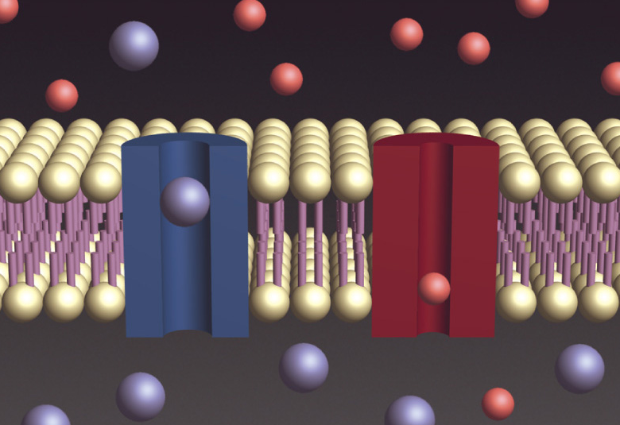
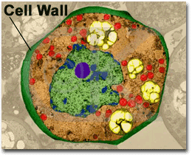
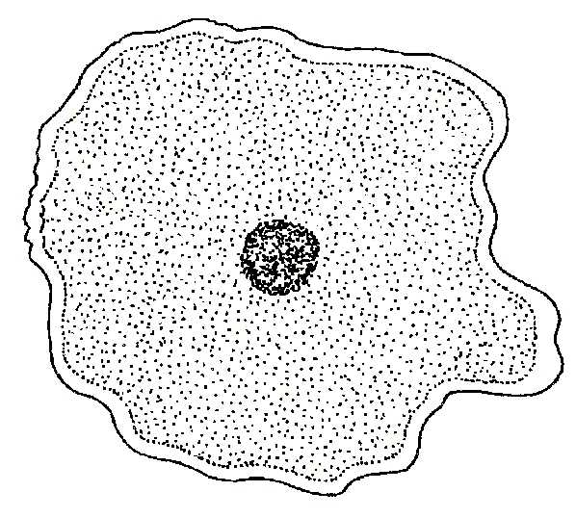
Cell Membrane
Cytoplasm

Slide 7
Prokaryotes and Eukaryotes
Biologists divide cells into two categories: eukaryotes and prokaryotes.
Eukaryotes HAVE a nucleus.
Prokaryotes DO NOT have a nucleus.

Slide 8
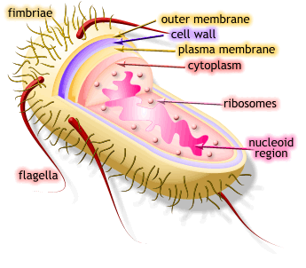
Prokaryotes
The cells of prokaryotes are generally smaller and simpler than the cells of eukaryotes.
Prokaryotes have cell membranes and cytoplasm but do not contain a NUCLEUS.
ALL bacteria are prokaryotes.
Ex: E. coli and Staphylococcus aureus.
Prokaryotes grow, reproduce and respond to changes in the environment.

Slide 9
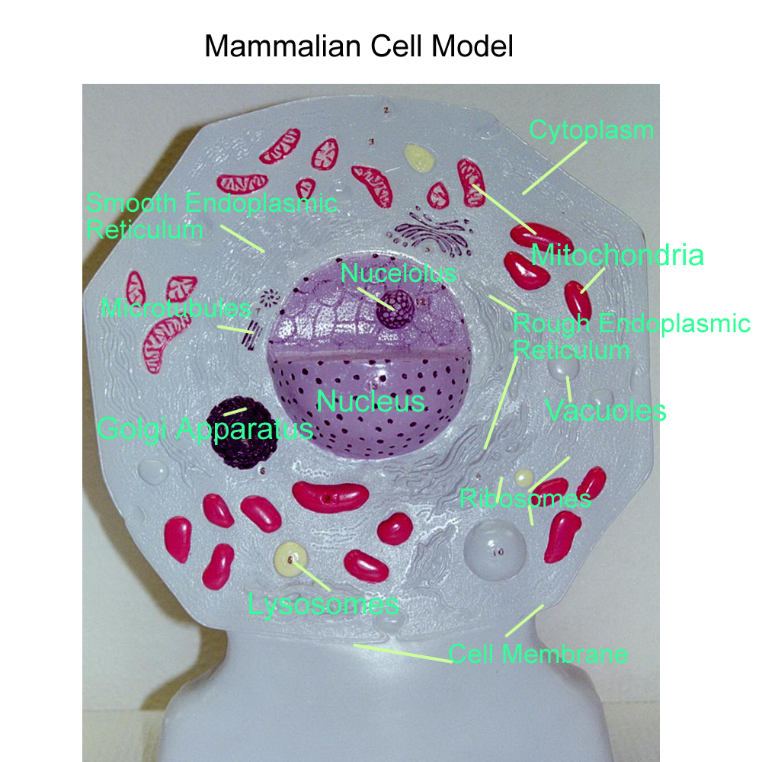
Eukaryote
Unlike the cells of prokaryotes, the cells of Eukaryotes do contain a NUCLEUS.
In addition to a nucleus, a cell membrane and cytoplasm, most cells of eukaryotes contain dozens of other specialized structures, called organelles.
Organelles are specialized structures that perform important cellular functions.
Although some eukaryotes live solitary live as single-celled organisms, many are large multicellular organisms.
All plants, animals, and fungi are eukaryotes, as well as many microorganisms.

Slide 10
Cell Structures
1. Cell Wall
Cell walls are found in many organisms, including plants, algae, fungi and nearly all prokaryotes.
The cell wall lies outside the cell membrane.
Most cell walls allow water, oxygen, carbon dioxide, and other substances to pass through them.
The main function of the Cell Wall is to provide support and protection for the cell.
Most cell walls are made from fibers of carbohydrate and protein.
Plant cell walls are made mostly of cellulose, a tough carbohydrate fiber.
Cellulose is the principal component of both wood and paper.
Cell Wall

Slide 11
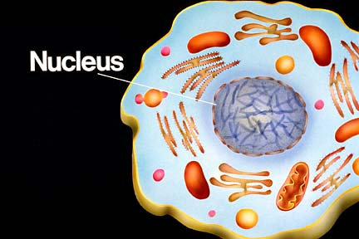
Cell Structures
2. Nucleus
The Scottish botanist Robert Brown first identified the nucleus in 1831.
The Nucleus controls most cell processes and contains the hereditary information of DNA (deoxyribonucleic acid).
Almost ALL eukaryotic cells contain a nucleus including plant and animal cells.
DNA holds the coded instructions for making proteins and other important molecules.

Slide 12
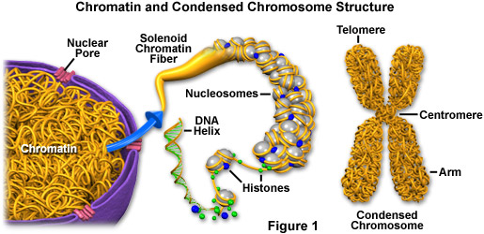
Cell Structures…
3. Chromatin and Chromosomes
The granular material visible within the nucleus is called Chromatin.
It consists of DNA bound to protein.
Most of the time, chromatin is spread throughout the nucleus.
When a cell divides, chromatin condenses to form Chromosomes.
These are distinct, threadlike structures containing the genetic information that is passed from one generation of cells to the next.

Slide 13
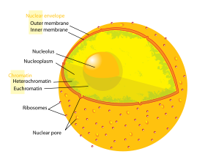
Cell Structures…
4. Nucleolus
The Nucleolus is the location inside the nucleus where the assembly of ribosomes begins.
Ribosomes aid in the production of proteins in the cell.
5. Nuclear Envelope
The nucleus is surrounded by a double-membrane layer called the Nuclear Envelope.
The Nuclear Envelope is dotted with thousands of nuclear pores which allow materials to move into and out of the nucleus.
The nucleus sends a steady stream of RNA and other information-carrying molecules to the rest of the cell through the nuclear pores.

Slide 14
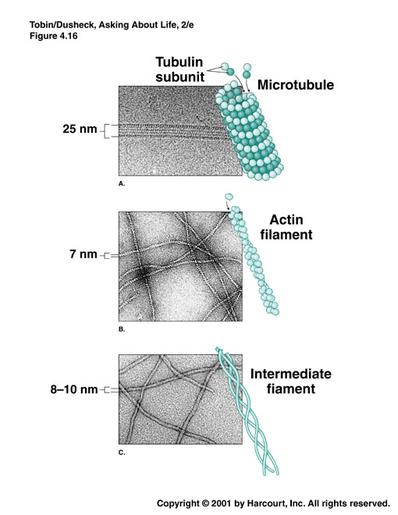
Cell Structures…
6. Cytoskeleton
The cytoskeleton is also involved in many forms of cell movement.
The cytoskeleton is made of microtubules and microfilaments.
Microtubules maintain cell shape and can also serve as “tracks” along which organelles are moved.
In some cells, bundles of microtubules form hair-like projections from the cell surface known as cilia and flagella that enable the cell to swim rapidly through liquids.
Microfilaments are long, thin fibers that function in the movement and support of the cell.

Slide 15
Cell Structures…
7. Ribosomes
Ribosomes are the sites for protein production.
Proteins are assembled on ribosomes.
Ribosomes produce proteins following coded instructions that come from the nucleus.
8. Endoplasmic Reticulum
Found in eukaryotic cells.
The Endoplasmic Reticulum is the organelle in which components of the cell membrane are assembled and some proteins are modified.
The part of the endoplasmic reticulum involved in protein synthesis is the Rough Endoplasmic Reticulum.
Newly made proteins move directly from the ribosomes to the Rough Endoplasmic Reticulum.
The smooth endoplasmic reticulum does NOT have proteins on it.
The smooth endoplasmic reticulum contains collections of enzymes that perform specialized tasks such as the synthesis of lipids.

Slide 16
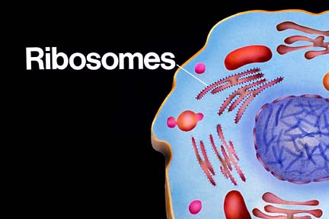
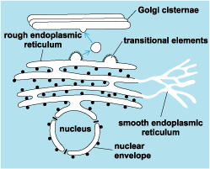
Ribosomes are found in the nucleus and on Rough Endoplasmic Reticulum.
Smooth Endoplasmic Reticulum contains NO ribosomes.
Rough Endoplasmic Reticulum HAS ribosomes.

Slide 17
Cell Structures…
9. Golgi Apparatus
A stack of membranes.
Enzymes in the Golgi Apparatus attach carbohydrates and lipids to proteins.
From the Golgi apparatus, proteins are sent to their final destination.
Packaging and Shipping of materials. THINK UPS
10. Lysosomes
Lysosomes are small organelles filled with enzymes.
One function of the Lysosomes is to break down lipids, carbohydrates and proteins from food into particles that can be used by the rest of the cell.
Lysosomes also help break down organelles that have outlived their usefulness.
Lysosomes help keep the cell clean from debris.

Slide 18
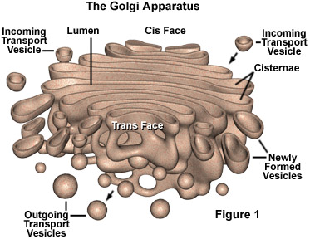
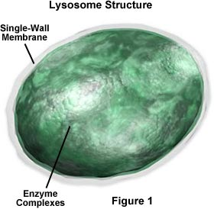
Cell Structures

Slide 19
Cell Structures…
11. Vacuoles
Cells often store materials such as water, fats, proteins, and carbohydrates in saclike structures known as vacuoles.
Many plant cells have a single large, central vacuole filled with liquid, as makes it possible for plants to support heavy structures such as leaves and flowers.
Vacuoles are also found in single-celled organisms and animal cells.
Smaller vacuoles are typically called vesicles.
12. Chloroplasts
The Chloroplasts are found in plants and some other organisms.
Animal and fungal cells DO NOT have chloroplasts.
Chloroplasts use the energy from sunlight to make energy-rich food molecules in a process known as photosynthesis.
The green pigment chlorophyll is located in the photosynthetic membranes surrounding the chloroplasts.

Slide 20
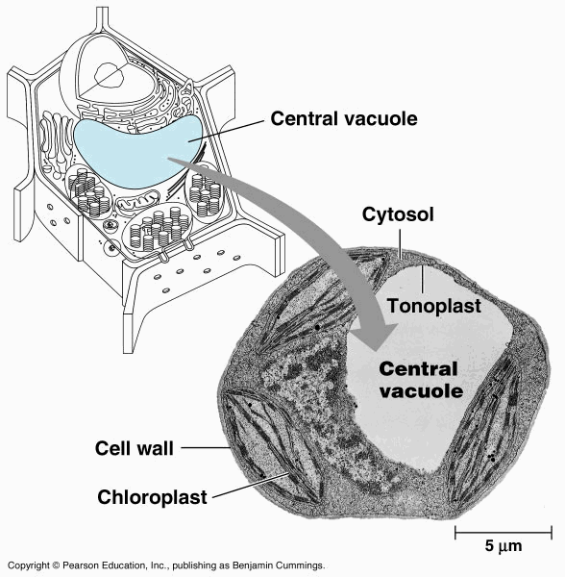
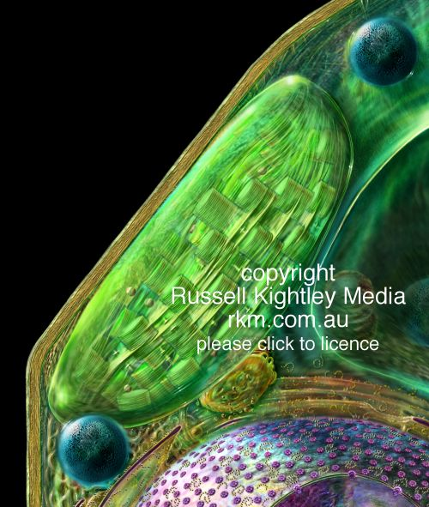
Cell Structures…

Slide 21
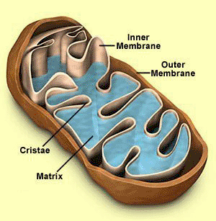
Cell Structures…
13. Mitochondria
The Mitochondria are organelles that release energy from stored food molecules.
Mitochondria use the energy from food to make high-energy compounds that the cell can use to power growth, development and movement.
The Mitochondria are the site of Cellular Respiration.
Mitochondria are enclosed by two envelope membranes, an out and inner membrane.
Mitochondria are found in nearly all eukaryotic cells.

Slide 22
Organelle DNA
Unlike other organelles, chloroplasts and mitochondria contain some of their own genetic information in the form of DNA.
The small DNA molecules contain information that is essential for the normal function of both organelles.
Mitochondrial DNA, as believed by many, is just the remnant of the genetic information of the bacteria from which mitochondria are descended.
In humans, all or nearly all of our mitochondria come from the cytoplasm of the ovum, or egg cell.
This means that when your relatives are discussing which side of the family should take credit for your best characteristics, you can tell them that you got your mitochondria from MOM.

Slide 23
Comparing Cells
Structure | Prokaryotic Cells | Eukaryotic (Animal) | Eukaryotic (Plant)
Cell Membrane | Yes | Yes | Yes
Cell Wall | Yes | No | Yes
Nucleus | No | Yes | Yes
Ribosomes | Yes | Yes | Yes
Endoplasmic Reticulum | No | Yes | Yes
Golgi Apparatus | No | Yes | Yes
Lysosomes | No | Yes | No
Vacuoles | No | Small or None | Yes
Mitochondria | No | Yes | Yes
Chloroplasts | No | No | Yes
Cytoskeleton | No | Yes | Yes

Slide 24
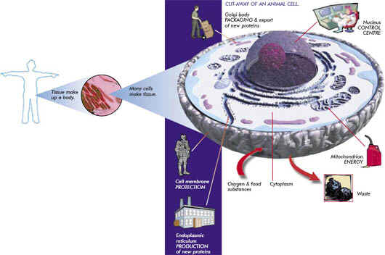

Slide 25
7-3: Movement Cell Membrane
The cell membrane regulates what enters and leaves the cell and also provides protection and support.
The cell takes in food and water and eliminates wastes through the cell membrane.
The core of nearly all cell membranes is a double-layered sheet called a Lipid Bilayer.
Lipid bilayers form by themselves when certain kids of lipids are dissolved in water.
The Bilayer gives cells a tough, flexible structure that forms a strong barrier between the cell and its surroundings.
Most cell membranes also contain protein molecules that run through the lipid Bilayer.
Carbohydrate molecules form chains that are attached to the outer surfaces of these proteins.
Some of the proteins help form channels and pumps that help to move material across the cell membrane.
Many of the carbohydrates act like chemical identification cards, allowing cells to identify

Slide 26
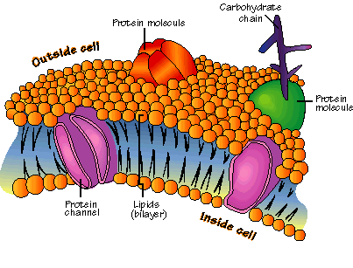
Cell Membrane

Slide 27
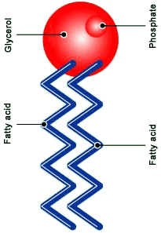
Phospholipid Molecule
Makes up the lipid bilayer.
Made of a polar head, phosphate group, and 2 fatty acid tails.
Polar heads are on the outside of the bilayer (hydrophillic).
Fatty acid tail face inward of the bilayer (hydrophobic).

Slide 28
Diffusion
Every living cell contains a liquid interior and is surrounded by liquid.
The cell membrane separates the solution that surrounds the cell from the solution within the cell.
One of the most important jobs of the cell membrane is to regulate what enters and exits the cell.
In a solution, molecules are in constant motion.
Because of movement and collisions, molecules tend to move from areas of greater concentration to less concentration.
Diffusion is defined as the movement of molecules from areas of high concentration to low concentration until they are balanced (reach Equilibrium).
Diffusion causes many substances to move across a cell membrane but does not require the cell to use energy.

Slide 29
Diffusion
Suppose two substances are present in unequal concentration on either side of a membrane. The substance that can cross the membrane will tend to move toward the area where it is less concentrated until equilibrium is reached.
At this point, the concentration on each side of the membrane will be equal.

Slide 30
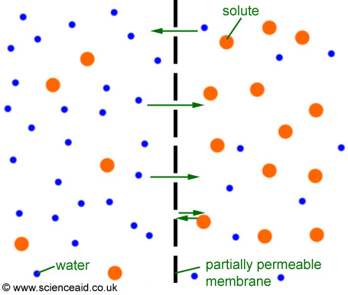
Osmosis
Not all substances cross biological membranes.
If a substance can pass through a membrane, the membrane is Permeable.
Most biological membranes are Selectively Permeable, meaning that some substances can pass across them and others cannot.
A process called Osmosis allows water molecules to pass easily through most biological membranes.
Osmosis is the diffusion of water through a selectively permeable membrane.

Slide 31
How Osmosis Works
Ex: Sugar in solution outside of a membrane.
Water is more concentrated outside the membrane because of the sugar.
Water will diffuse into the cell until the concentration of water and sugar are equal.
Isotonic means the two solutions are equal.
Hypertonic means more concentrated.
Hypotonic means less concentrated.

Slide 32
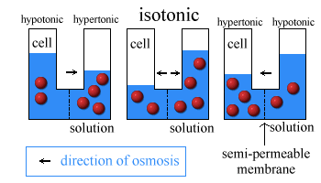
Osmosis

Slide 33
Osmotic Pressure
Osmosis exerts a pressure known as osmotic pressure on the hypertonic side of a selectively permeable membrane.
Osmotic pressure should typically produce a net movement of water into a typical cell that is surrounded by fresh water.
This causes a cell to swell.
Most cells however exist in isotonic solutions and do not need to worry about swelling.
Cell walls in plants prevent osmotic pressure from destroying plant cells.

Slide 34
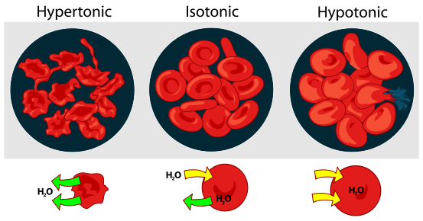
Osmotic Pressure

Slide 35
Facilitated Diffusion
Some molecules, including alcohol, water and small lipids, can move through the lipid Bilayer and diffuse directly across the cell membrane.
Other molecules cannot cross the lipid Bilayer but do diffuse across the membrane.
Many membranes have protein channels that allow molecules to cross the membrane.
These protein channels are specific to molecules and help Facilitate the diffusion of the molecule.
Ex: Glucose in red blood cells.
Diffusion that occurs with these “helper” molecules is Facilitated Diffusion.

Slide 36
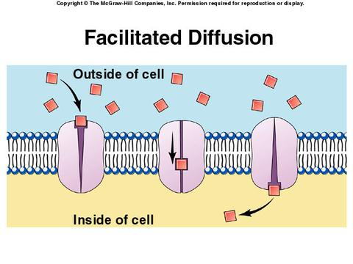
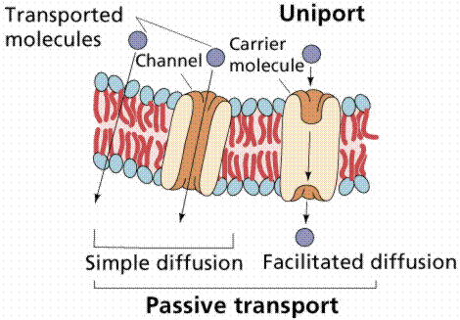
Facilitated Diffusion

Slide 37
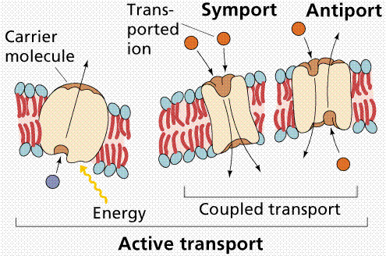
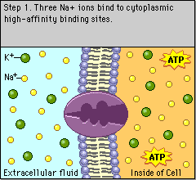
Active Transport
Often materials need to move from an area of lower concentration to an area of higher concentration.
Active transport is the movement of these materials and requires the input of ENERGY.
Active transport of small molecules is often compared to a pump.
Ex: animal cells pump sodium ions out of a cell and potassium ions in.
There is typically a high concentration of potassium but a low concentration of sodium.

Slide 38
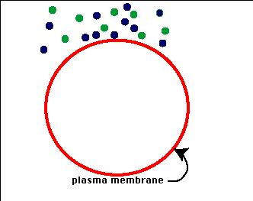
Active Transport
In Endocytosis, large amounts of material are taken into the cell by means of infolding, or pockets, formed by the cell membrane, then transformed into vacuoles.
When large molecules are taken into the cell and stored that is called Phagocytosis.

Slide 39
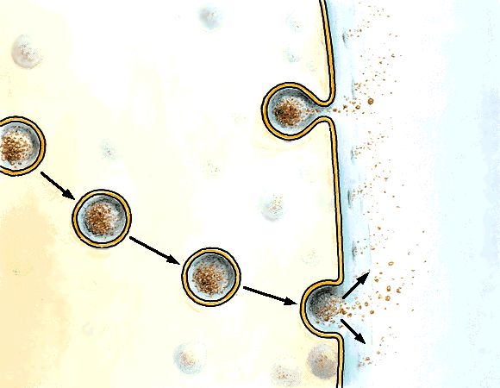
Active Transport
The removal of large amounts of material from a cell is known as Exocytosis.
During exocytosis, the membrane of the vacuole surrounding the material fuses with the cell membrane, forcing the contents out of the cell.

Slide 40
Unicellular Organisms
Cells are the basic living units of all organisms, but sometimes a single cell is a little more than that.
Sometimes a cell IS the organisms.
Unicellular organisms do everything that you would expect a living thing to do.
They grow, respond to the environment, and reproduce.
Unicellular organisms include both prokaryotes and eukaryotes.
Prokaryotes, especially bacteria, are highly adaptable and can live almost anywhere.
Many eukaryotes such as algae and yeast are also widespread.
Some unicellular species are solitary, some colonial.

Slide 41
Multicellular Organisms
The cells of multicellular organisms do not live on their own.
They are interdependent and each has a specific job to do.
Multicellular organisms have Cell Specialization, or separate roles for cells.
Cells in multicellular organisms are specialized to perform particular functions within the organism.
Ex: pancreatic cells, heart cells, skin cells, stomach cell.

Slide 42
Levels of Organization
The levels of organization in a multicellular organism are individual cells, tissues, organs, organ systems, organism.
Cells are the basic unit of structure and function for all living things.
There are many different types of cells such as nerve cells, cardiac cells, skin cells etc…
A Tissue is a group of similar cells performing the same function.
Ex: cardiac cells compose cardiac tissue.
When many groups of tissues work together they form an organ.
Ex: Cardiac tissue makes the heart.
When a group of organs work together to perform a given task they are an organ system.
Ex: the circulatory system.

Slide 43
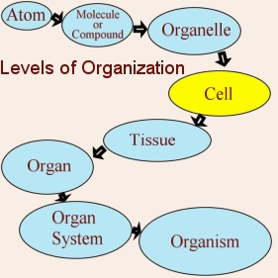
Levels of Organization…

