Slide 1
The Cell-The Basic Unit of Life
A Look Through the Microscope

Slide 2
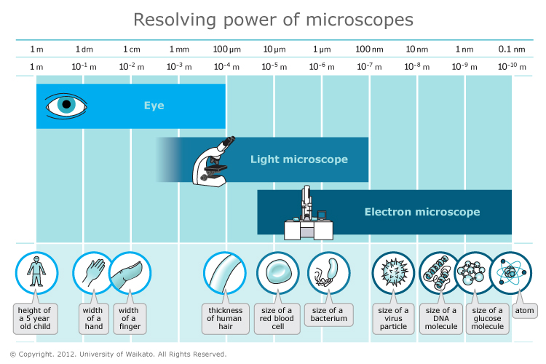

Slide 3
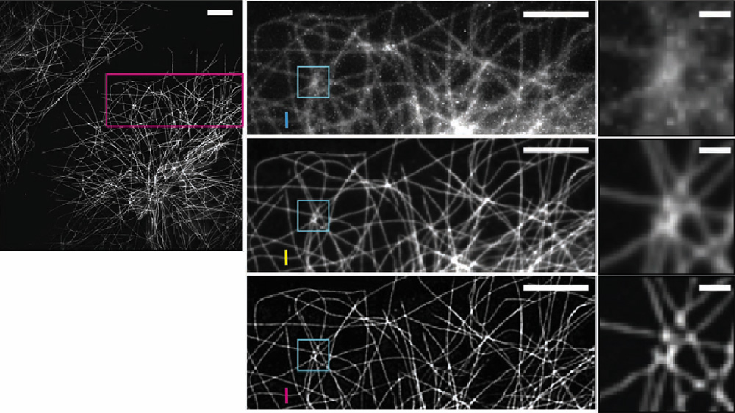
Microscope Resolution

Slide 4
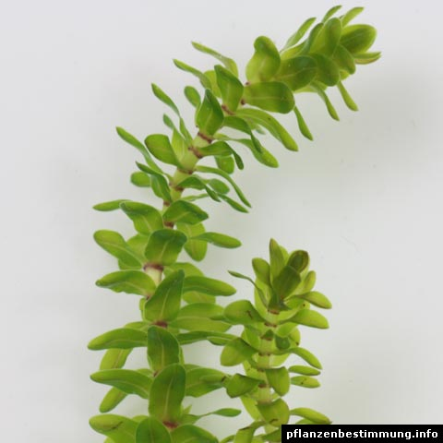
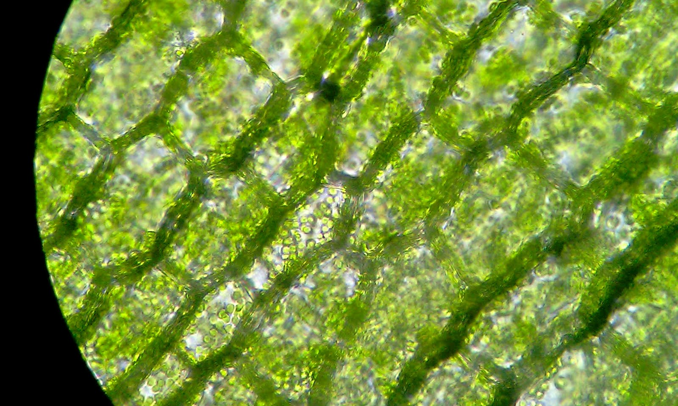
Elodea Leaf

Slide 5
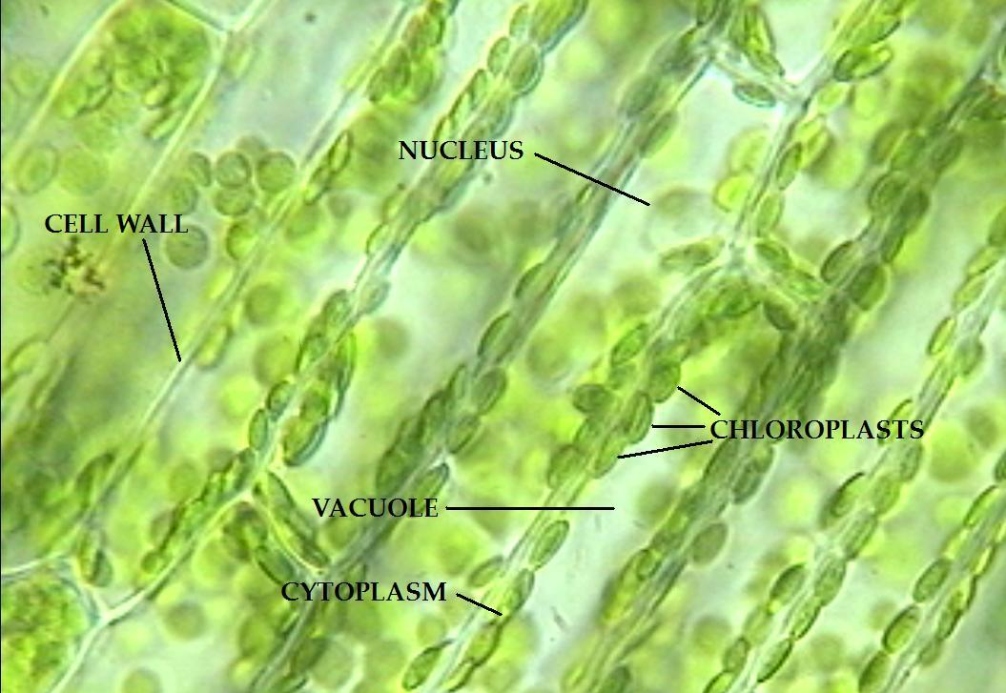
Elodea Cells

Slide 6
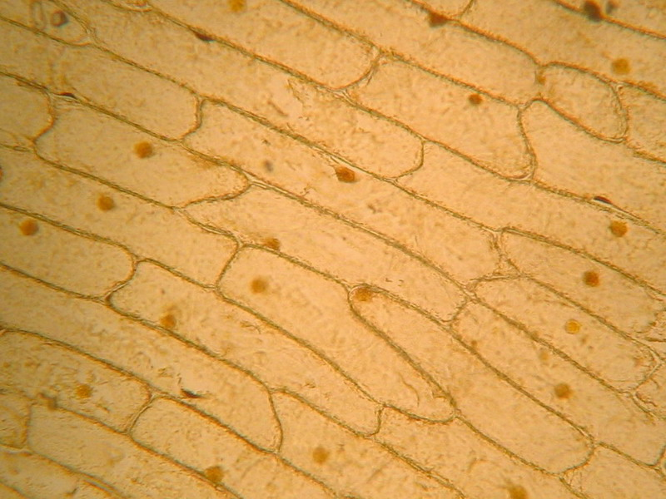
Onion Cells

Slide 7
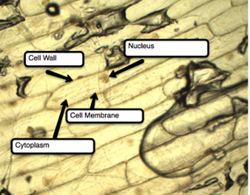

Slide 8
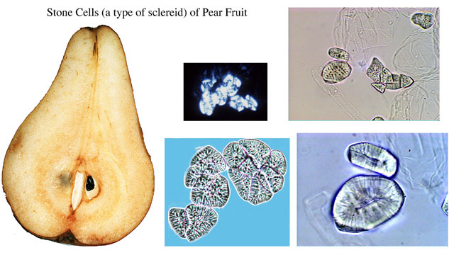
Pear Cells

Slide 9
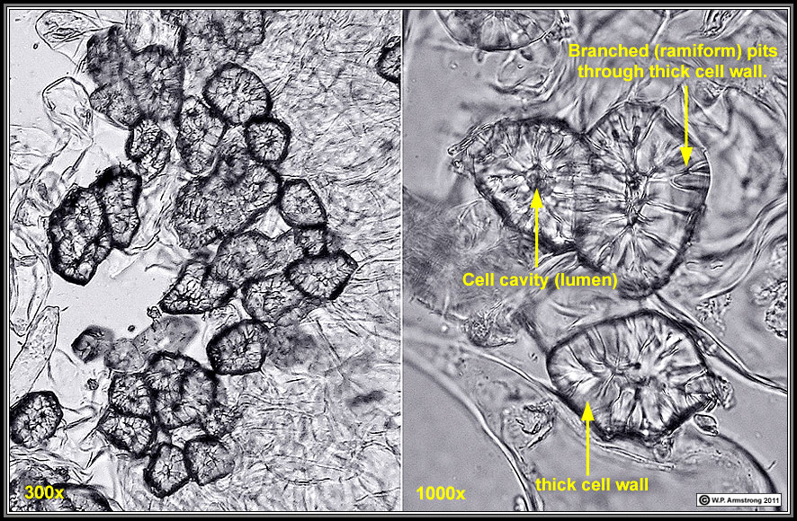
Stone Cells

Slide 10
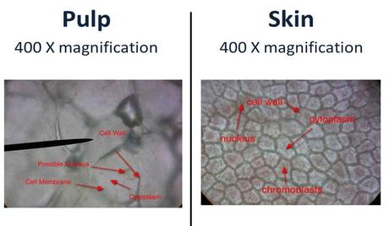
Tomato Skin Cells

Slide 11
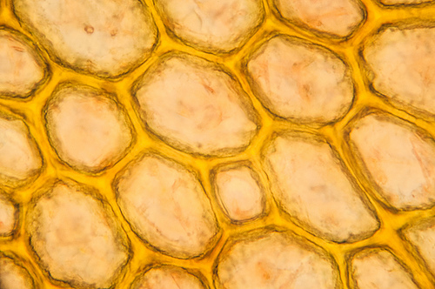
Tomato Skin Cells

Slide 12
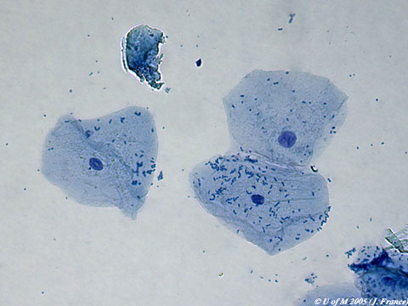
Human Cheek Cell

Slide 13
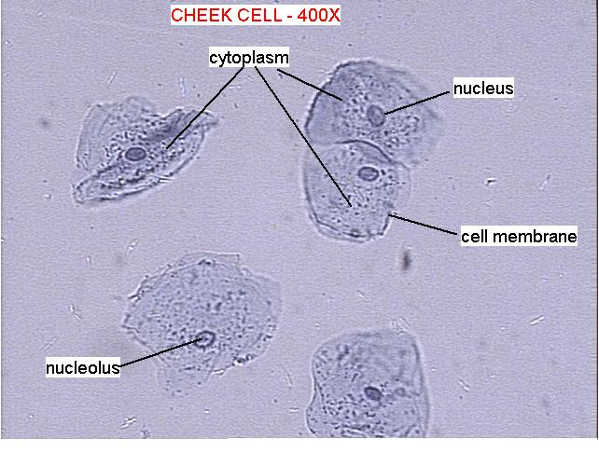
Human Cheek Cell

Slide 14
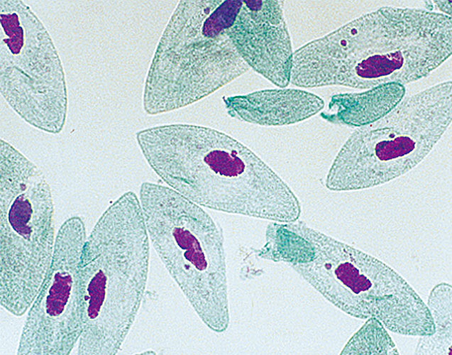
Paramecium—unicellular eukaryote

Slide 15
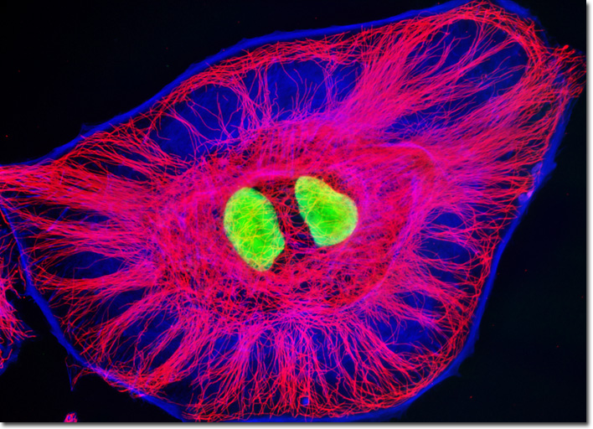
Cytoskeleton

Slide 16
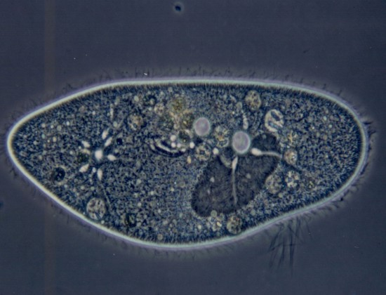
Paramecium

Slide 17
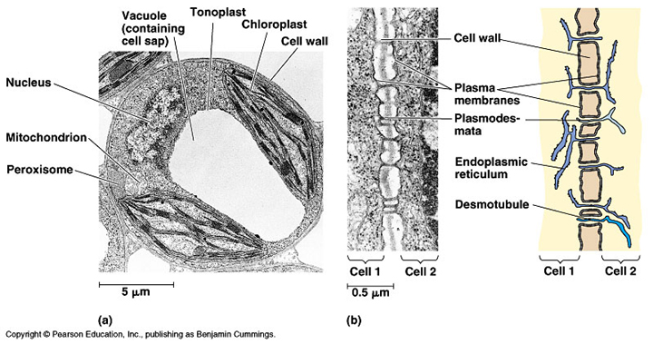
Real Plant Cell

Slide 18
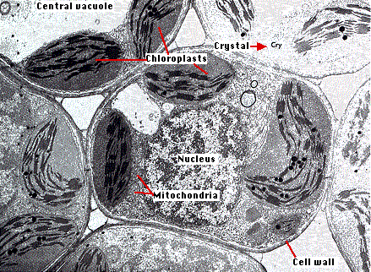
Real Plant Cell

Slide 19
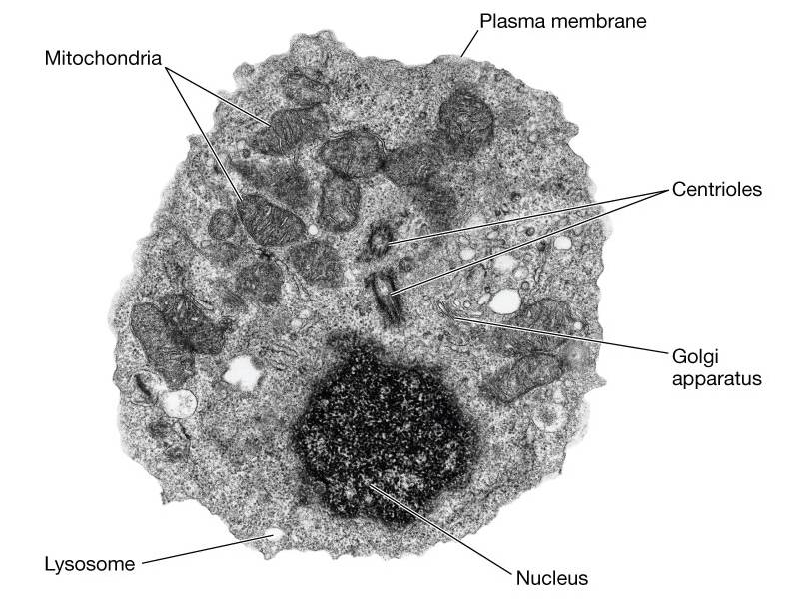
Typical Animal Cell

